Slide 1
Project Title: Secure Data Hiding in Image Using Steganography
CAPSTONE PROJECT
Presented By: GITI PARNA PAUL
Student Name : GITI PARNA PAUL
College Name : ST THOMAS COLLEGE OF ENGINEERING AND TECHNOLOGY
Department : COMPUTER SCIENCE ENGINEERING(CSE)

Slide 2
OUTLINE
Problem Statement
Technology used
Wow factor
End users
Result
Conclusion
Git-hub Link
Future scope

Slide 3
Problem Statement
This project implements secure data hiding in images using steganography, ensuring confidentiality and restricted access. It utilizes pixel-level embedding to encode a secret message within an image, requiring a passcode for decryption. The approach maintains image quality while ensuring data security, making it suitable for confidential communication.

Slide 4
Technology used
Libraries and Platforms Used:
Python: Primary programming language.
OpenCV : Used for image processing and manipulation.
OS Module : Helps in opening the encrypted image.
String Module : Assists in character encoding (optional, if needed).
Platform: IDLE Python,Windows,Github.

Slide 5
Wow factors
Minimal Image Distortion:
The approach selectively modifies pixel values rather than altering entire image regions, reducing noticeable distortions and making detection difficult.
Cross-Platform Compatibility:
While optimized for Windows, the code can be easily modified for other operating systems, making it adaptable.
No External Dependencies Beyond OpenCV:
Unlike many steganography methods requiring additional cryptographic libraries, this method only relies on OpenCV , making it lightweight and easy to integrate into various applications.

Slide 6
End users
Students & Researchers
Useful for those studying steganography and exploring secure data hiding techniques for academic projects or research purposes.
Privacy-Conscious Individuals
People who want to hide personal or sensitive information within images to prevent unauthorized access.
Cybersecurity Enthusiasts
Individuals experimenting with security techniques for safe data transmission without drawing attention

Slide 7
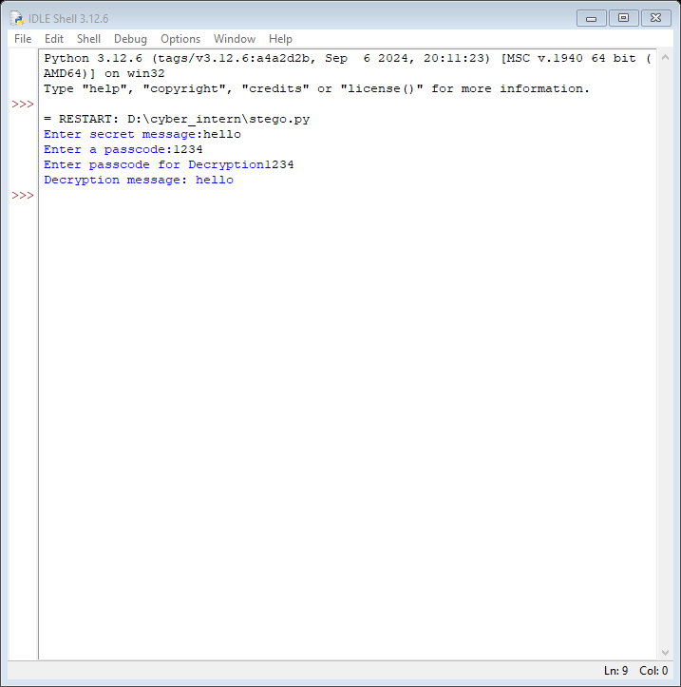
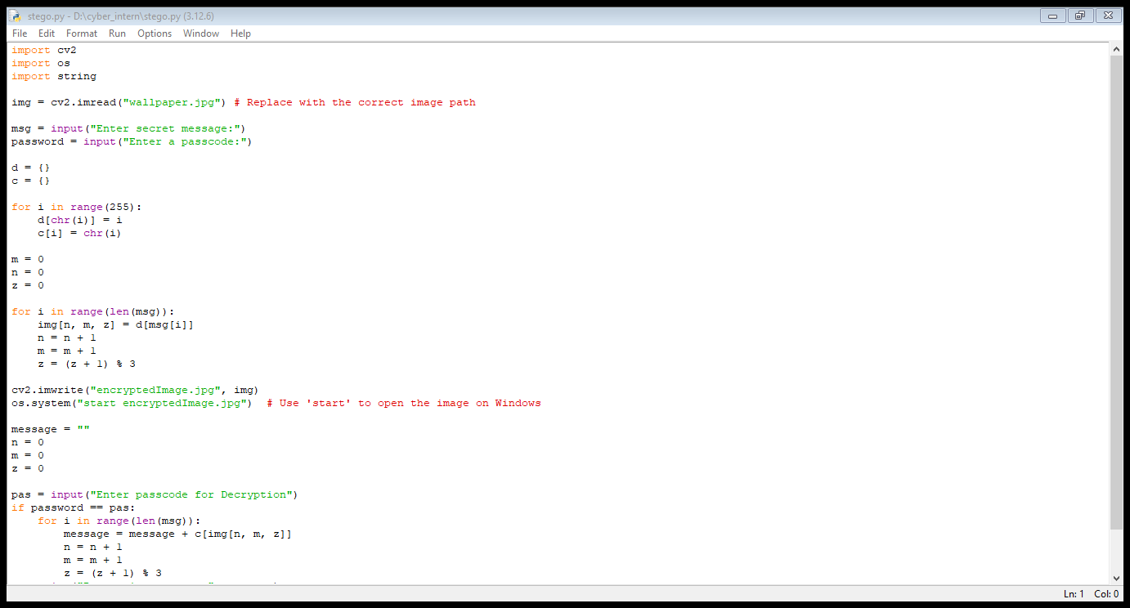
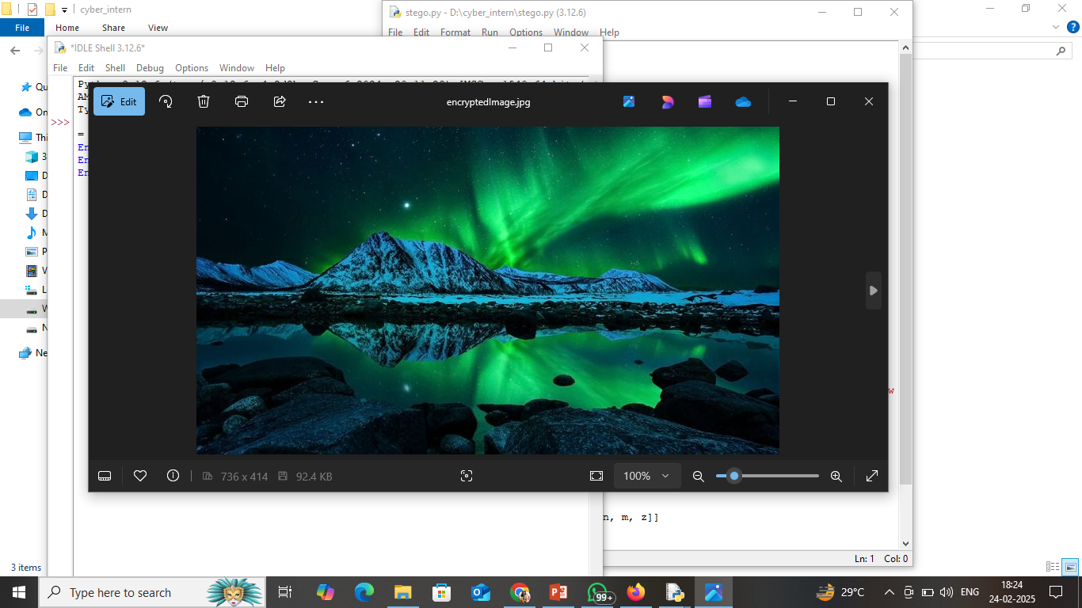
Results

Slide 8
Conclusion
This project successfully implements secure data hiding in images using steganography, addressing the need for confidential and imperceptible communication. By embedding secret messages into image pixels with minimal distortion, it ensures that sensitive information remains hidden from unauthorized access. The integration of a passcode-protected decryption mechanism further enhances security, making data retrieval possible only for intended recipients.
Compared to traditional steganography methods, this approach offers simplicity, efficiency, and lightweight execution, making it suitable for personal security, cybersecurity applications, and covert data transmission. The project demonstrates how steganography can be an effective tool for secure communication in digital environments while maintaining the visual integrity of the carrier image.

Slide 9
GitHub Link
https://github.com/Giti03/cyber_stego.git

Slide 10
Future scope(optional)
Integration with Cryptography 🔐
Enhancing security by encrypting the message before embedding it into the image, adding an extra layer of protection against brute-force attacks.
2. Support for Multiple File Formats 📂
Expanding beyond images to hide data in videos, audio files, and PDFs for broader secure communication applications.
3 Cloud-Based Secure Data Hiding ☁️
Developing a web-based or mobile application that allows users to securely embed and retrieve hidden messages over the internet.

Slide 11
THANK YOU

